Slide 1
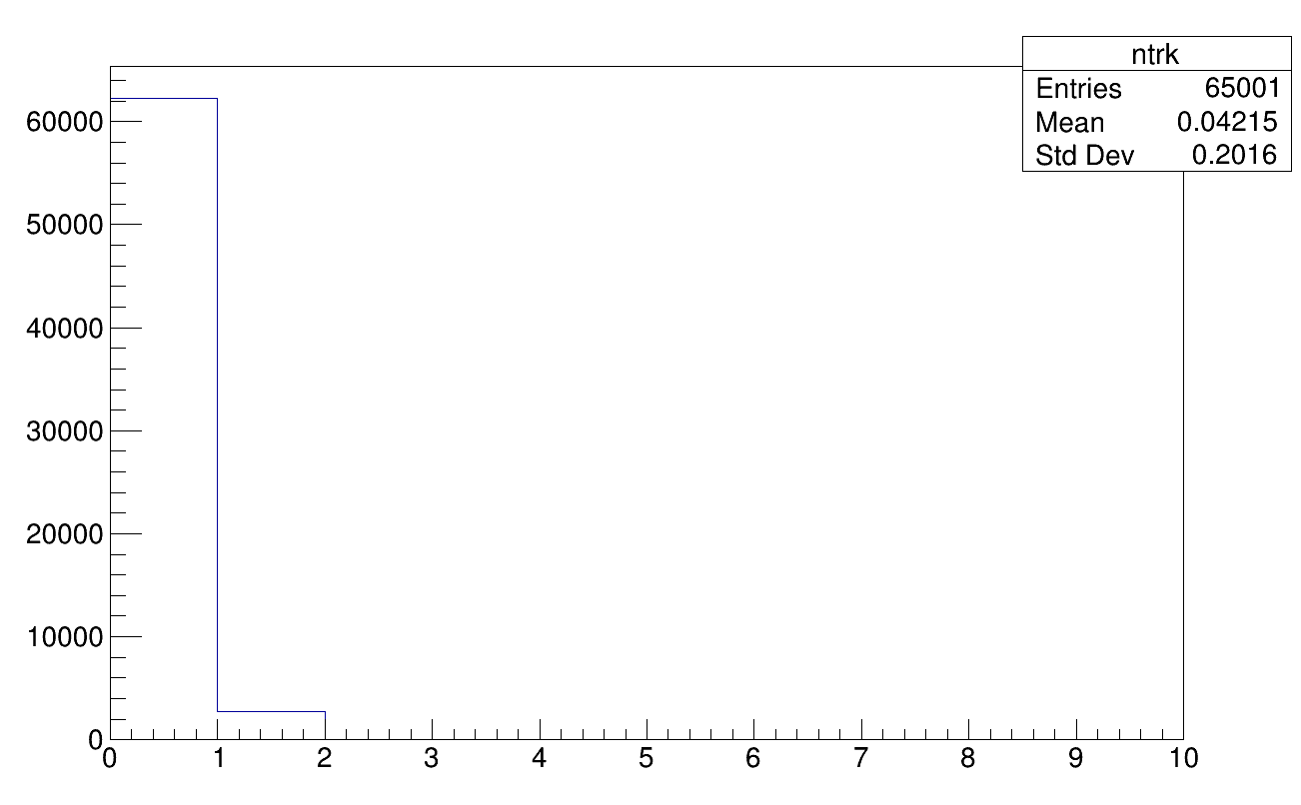
Experimental data issues
GLB tracking
4 points (VT) + 1 (TW)
High inefficiency in track
reconstruction
Is it a problem of VT?

Slide 2
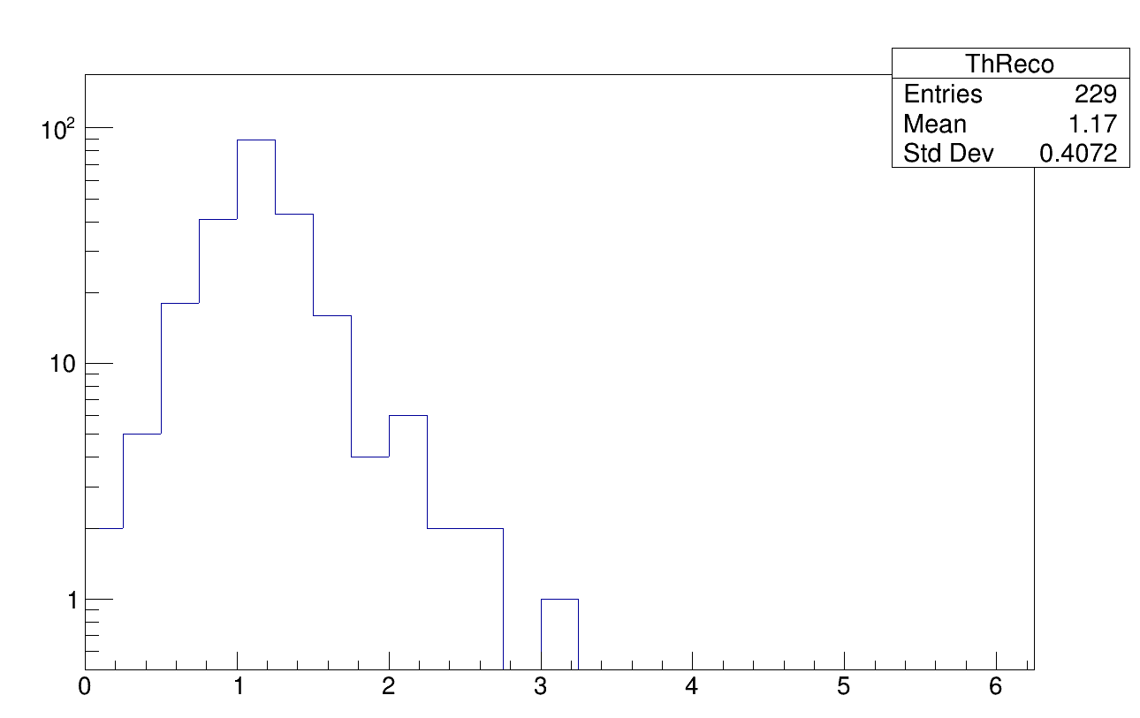
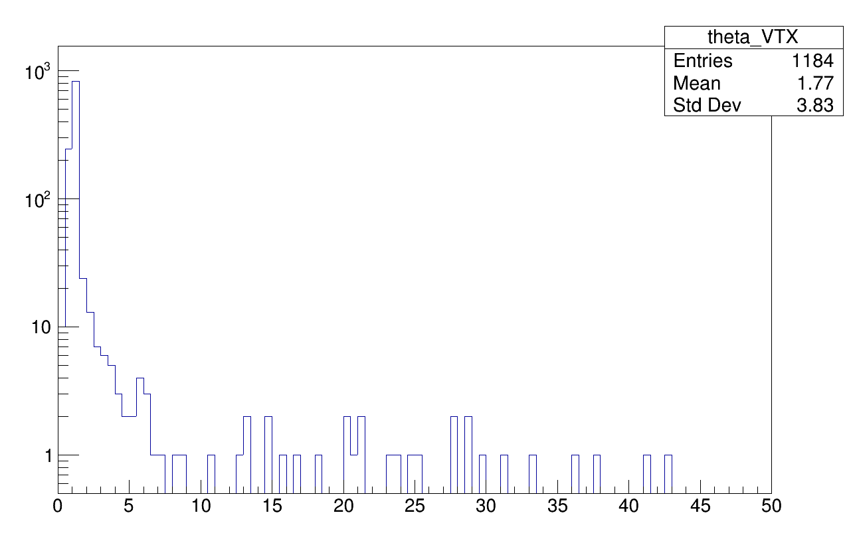
Global vs VT theta
Global theta
VT theta
It seems tracks with wider angle aperture are not reconstructed

Slide 3
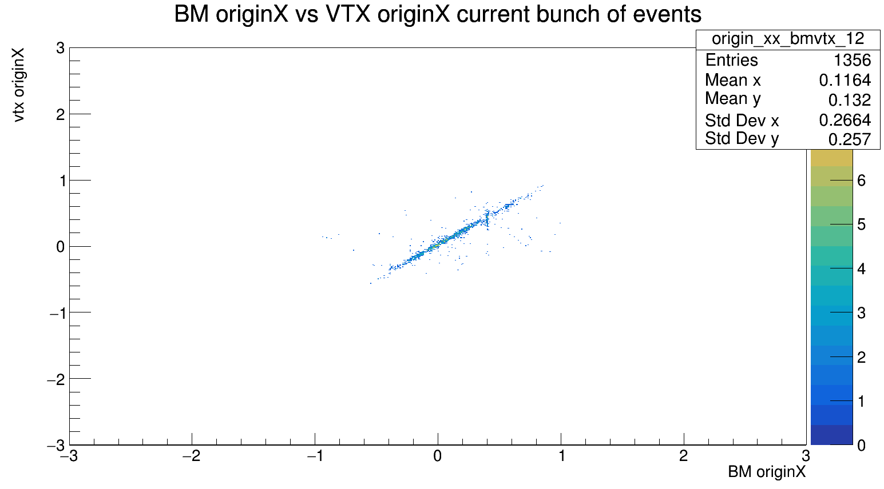
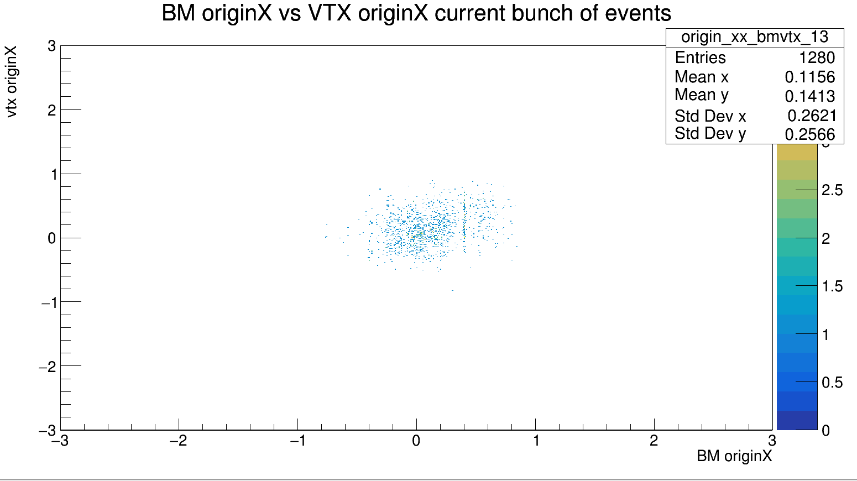
VT synch
correlazione tracce bm-vtx per eventi fino a 60 k
correlazione tracce bm-vtx per eventi da 60k a 65k
→ events up to 65000 are synchronized

Slide 4
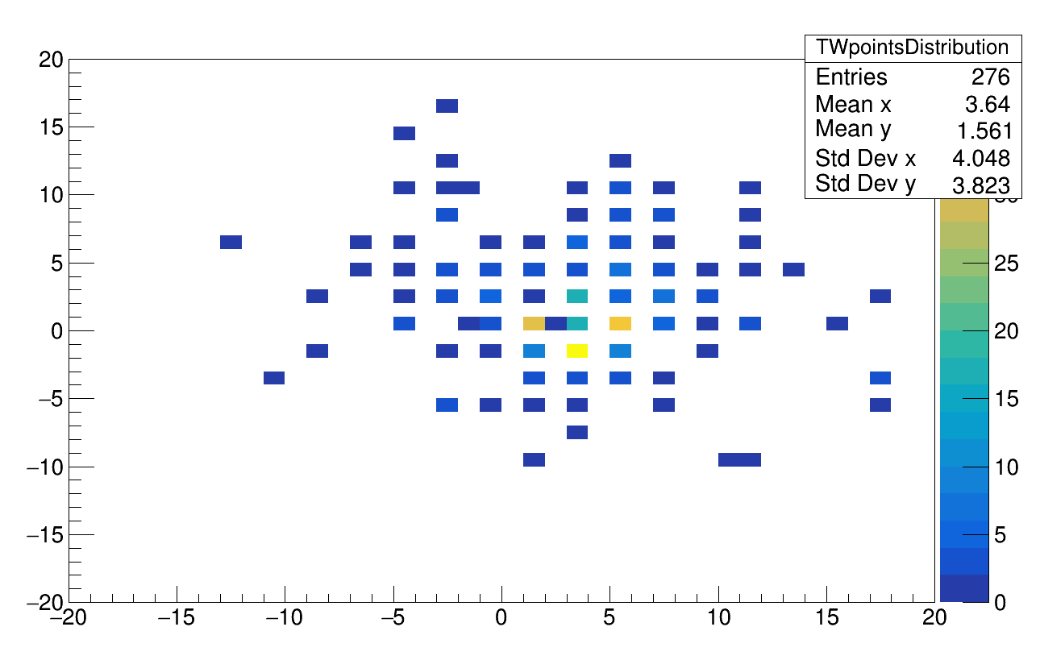
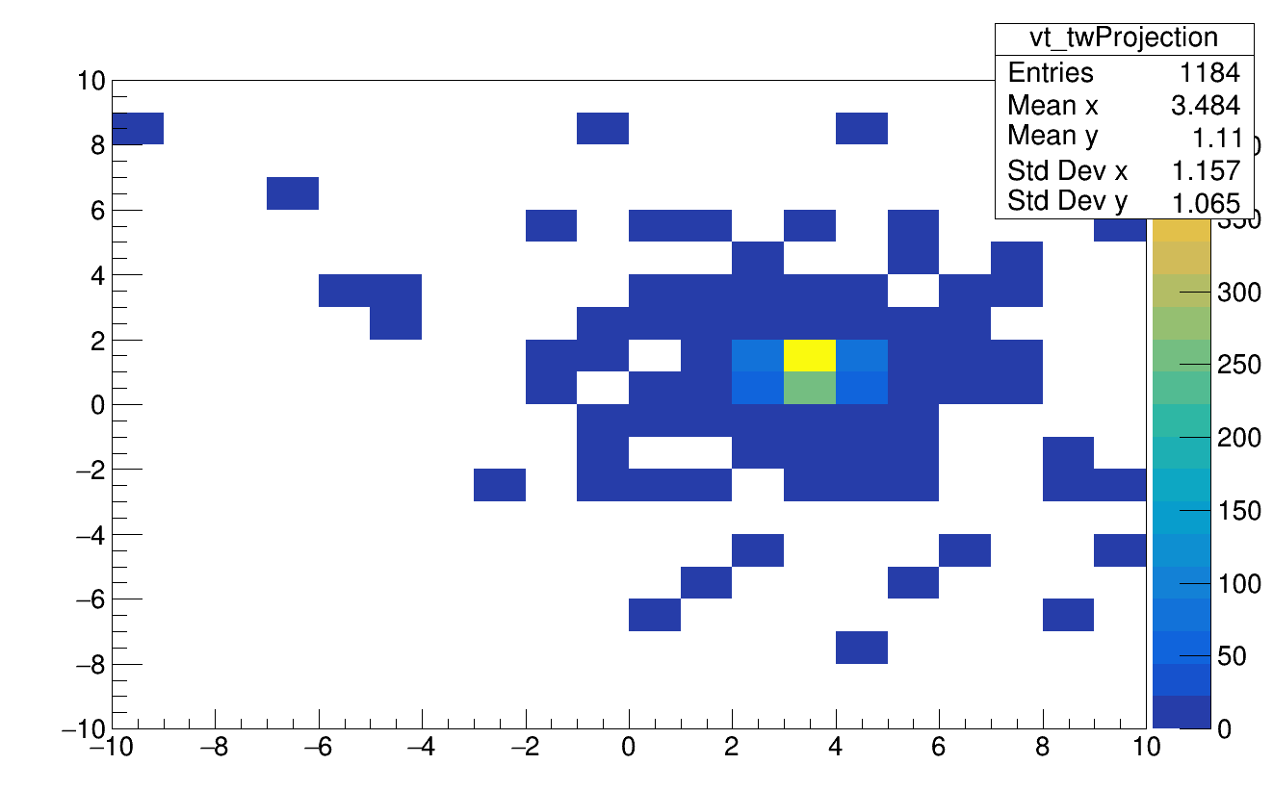
fragments
Projection of the tracklet in
the TW in global frame
TW points (global frame)
→ TW is shifted wrt to vtx

Slide 5
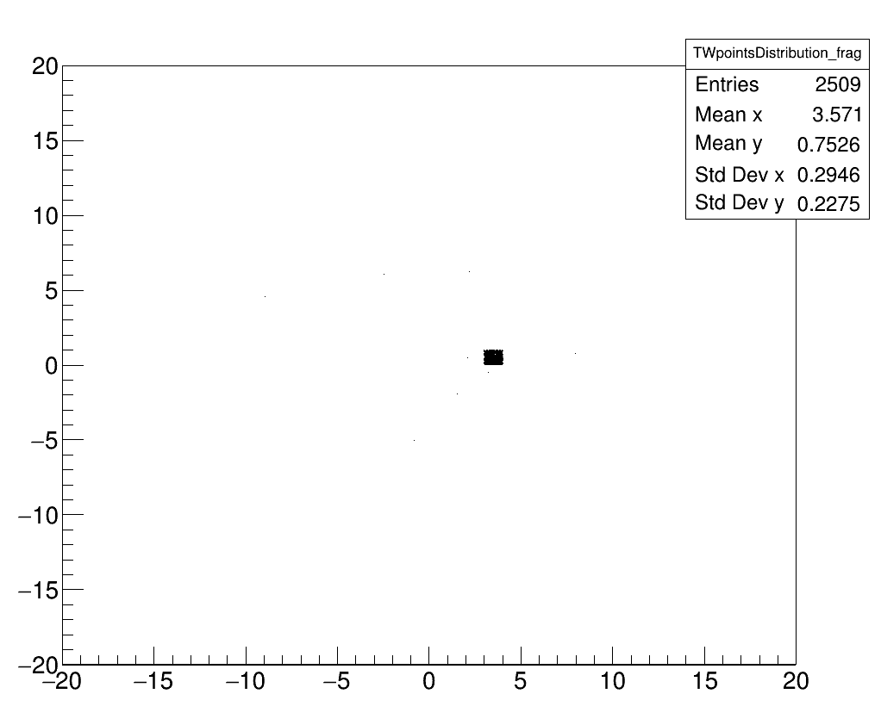
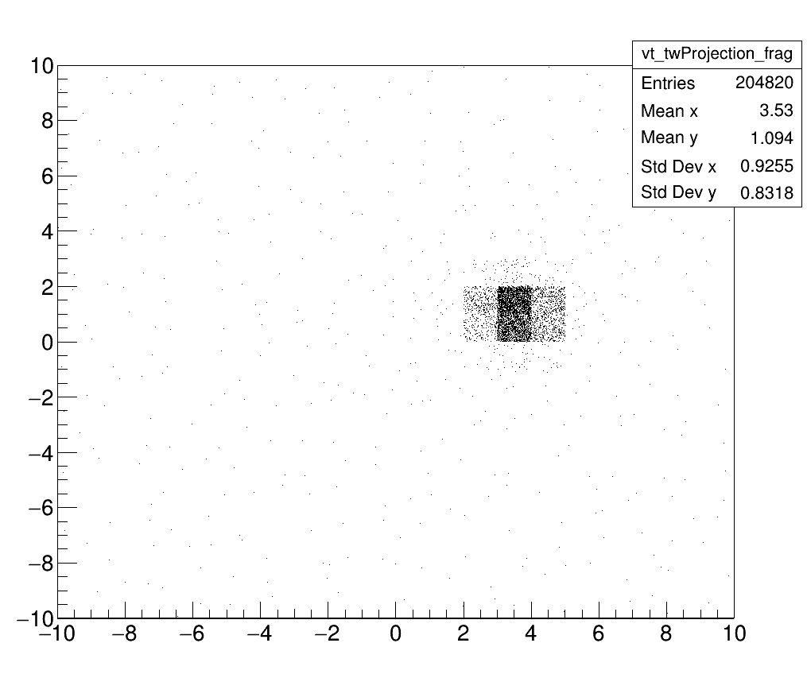
beam
TW points (global frame)
Projection of the tracklet in
the TW in global frame
→ TW is shifted wrt to vtx

Slide 6
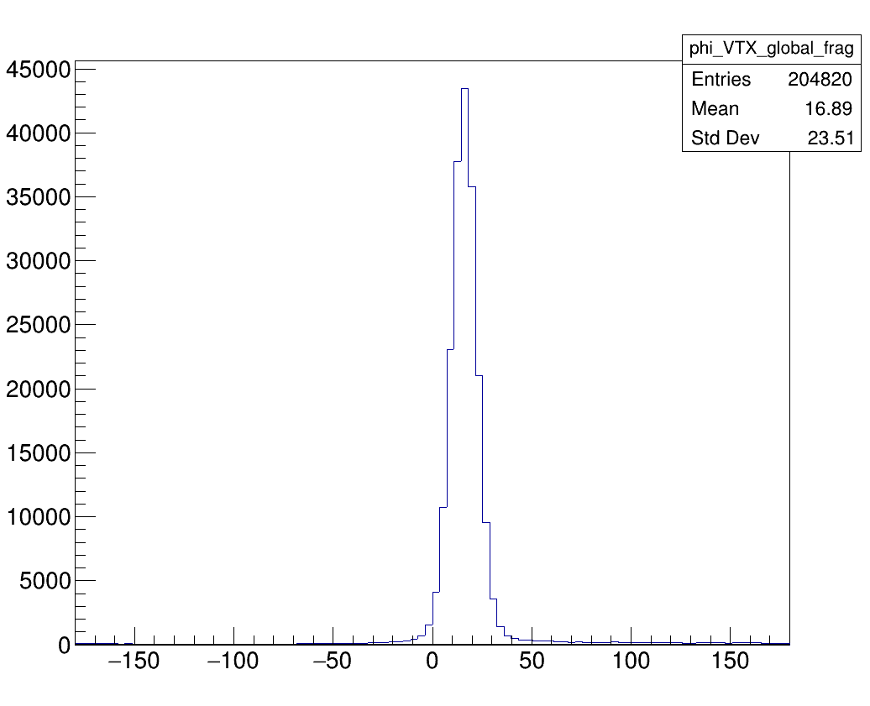
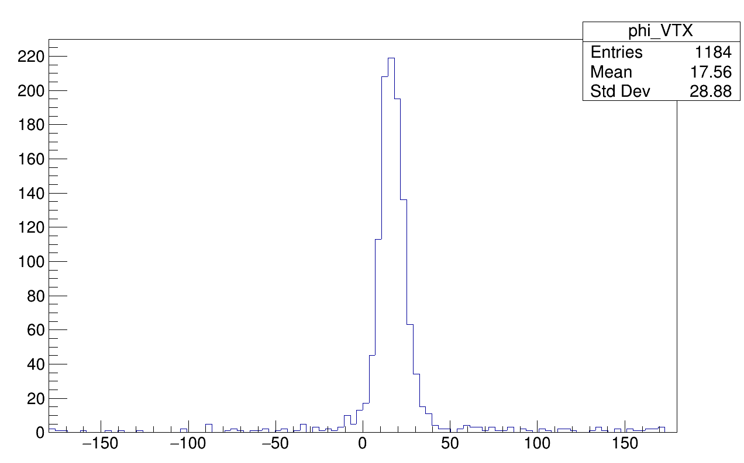
frags
oxygen
Azimutal distribution peaked around 18° → is the VT tilted?

Slide 7
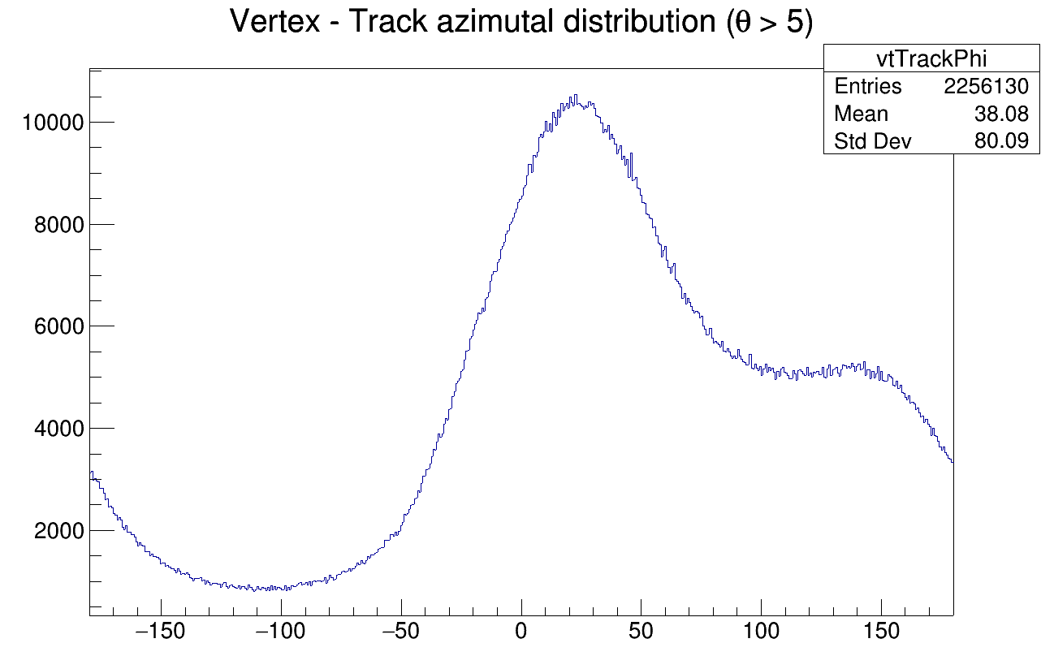
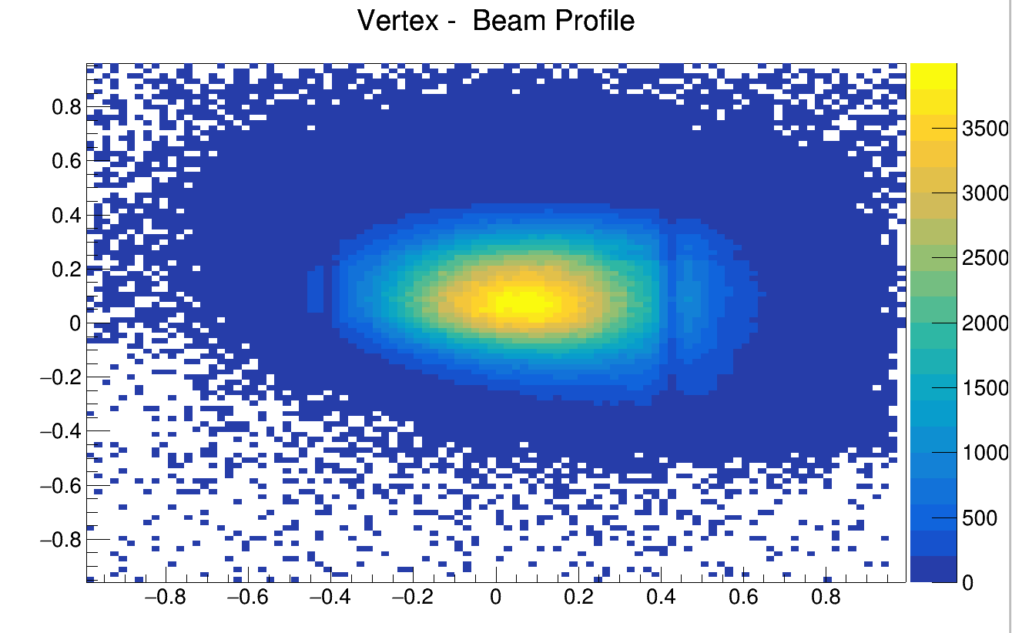
Phi distribution of ORIGIN of tracklets

Slide 8
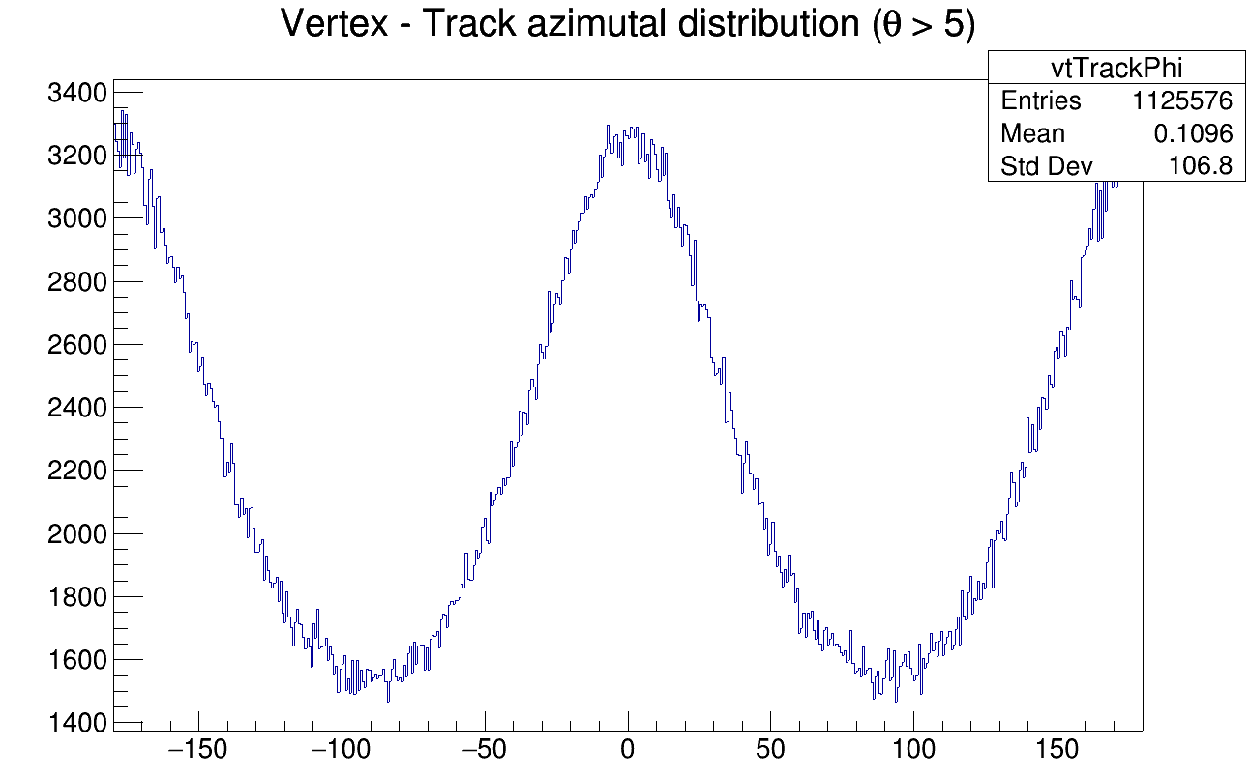
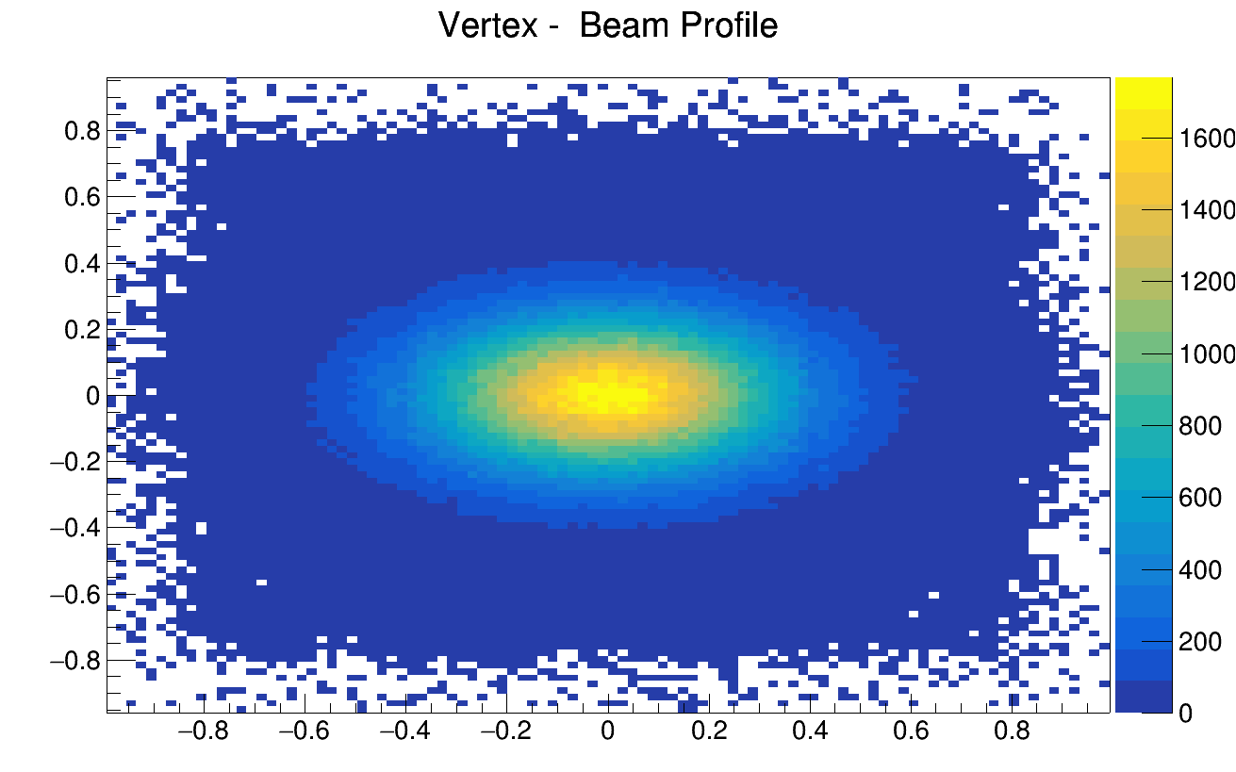
MC Phi distribution of ORIGIN of tracklets

Slide 9
